Slide 1

Getting Started With Command Line
KG MICROCOLLEGE

Slide 2
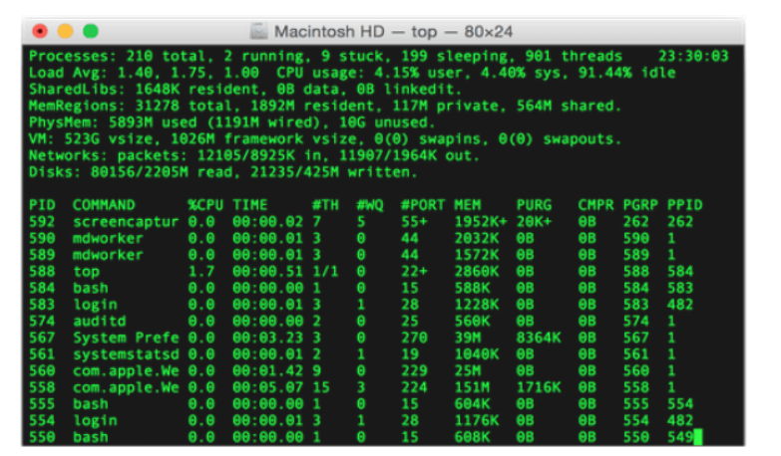
User Interface:
Graphical User Interface:
Graphical User Interface (GUI) commonly referred as the User Interface (UI).
Command Line Interface:
Command Line Interface (CLI) facilitates the users to perform powerful operations on a computer with simple commands.
Command is a text instruction to a computer program to perform a specific task.

Slide 3
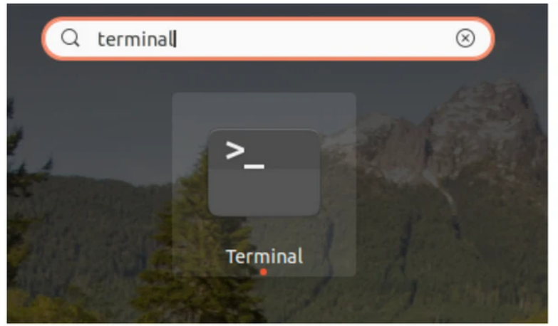
What is Shell?
Shell is the software that interprets and executes the various commands that we provide.
Terminal is a text input/output environment.
Different Shells:
Bourne Shell (sh)
Bourne-Again Shell (bash)
C Shell (csh)
Korn Shell (ksh)
Z Shell (zsh)
Opening Terminal:
Bash is one of the most commonly used shell in Linux distributions.
Open the Dash (Super Key) or Applications and type terminal.
Shortcut: Ctrl + Alt + T

Slide 4
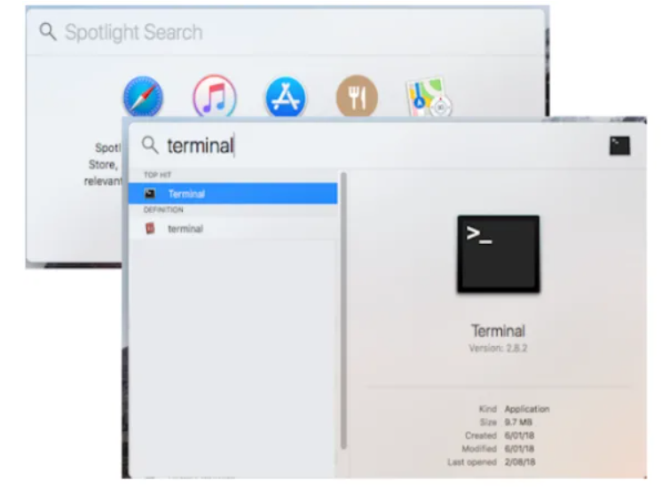
Opening Terminal (in MAC):
Open Launchpad and search for terminal.
Press command(⌘) + space, type "terminal".

Slide 5
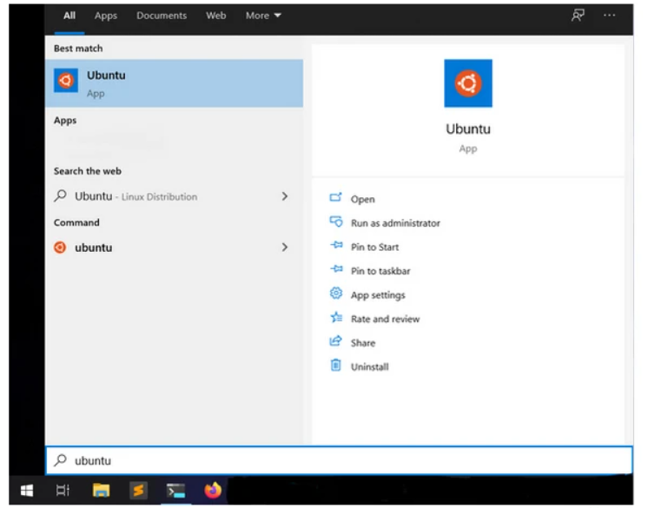
For Windows Operating System:
For windows install WSL2 (Windows Subsystem for Linux).
Opening WSL2 Ubuntu Terminal:
Click Start and search for "Ubuntu".
https://shell.cloud.google.com/ (Using Cloud).

Slide 6
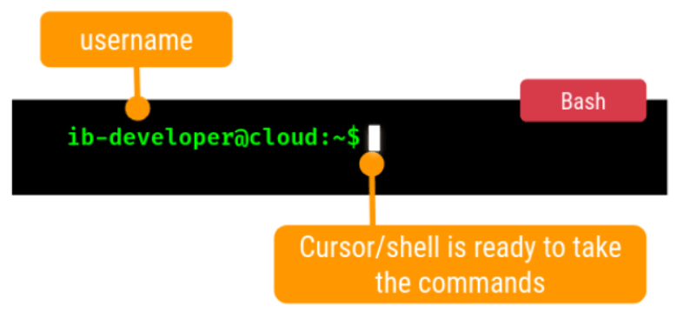
Bash:
Bash is the GNU Project's shell—the Bourne Again SHell. This is an sh-compatible shell that incorporates useful features.

Slide 7
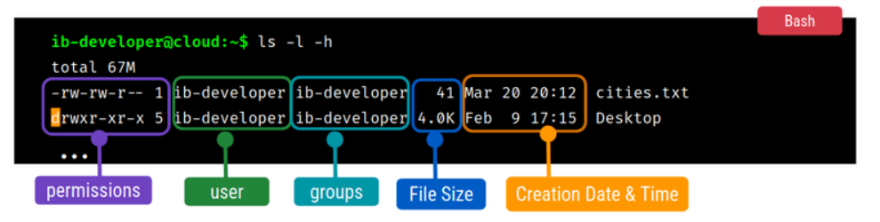
Basic Linux Commands:
Listing Files & Directories:
ls is used to list files and directories.
Using Additional Options:
-l -h option provides details in human readable format.

Slide 8
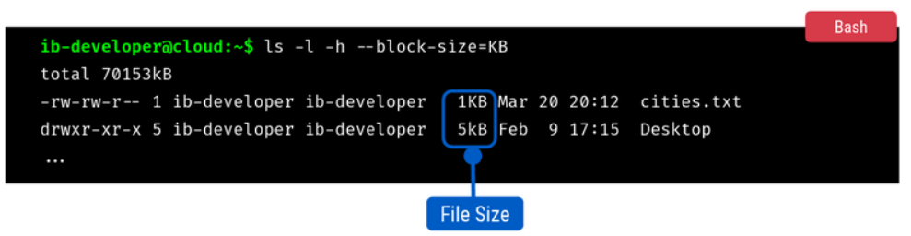
Some options require values arguments/values to be passed.
--block-size option rounds the file size to nearest values.
Inputs : KB , MB

Slide 9
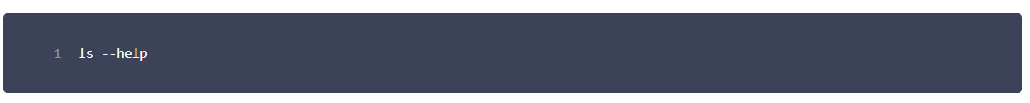
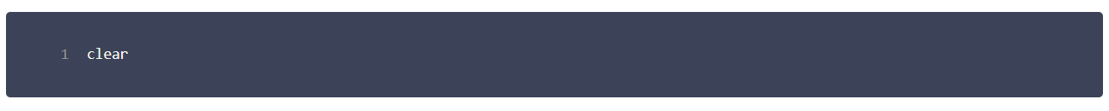
Get Options for Commands:
help displays a list of options that you can use with the command.
This Command will be helpful when you don’t know about its parameters and return type etc.
Clear the Screen:
clear command clears the terminal.
Shortcut: Ctrl+L .

Slide 10
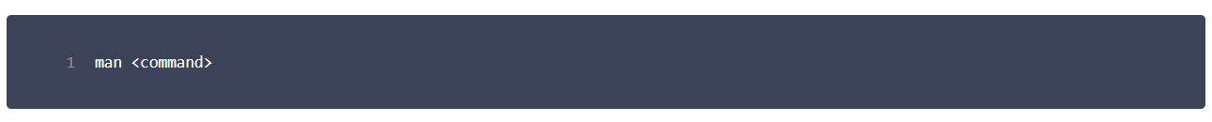
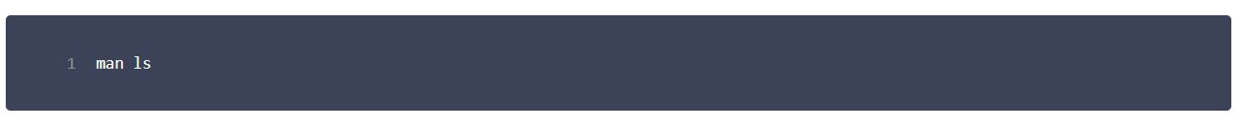
Get User Manual for Commands:
man displays the user manual of a command.
Here we pass the command as an argument.
Type q to exit the manual

Slide 11
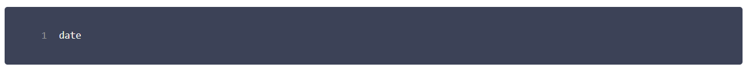

Get System Date & Time:
date displays the system date and time.
Get Current User:
whoami displays the current logged in user.
Previous Commands:
Shell keeps track of the commands you have typed in.
Use up ( ⬆) and down ( ⬇) arrows to access the commands.

Slide 12
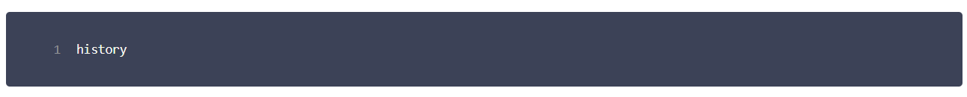
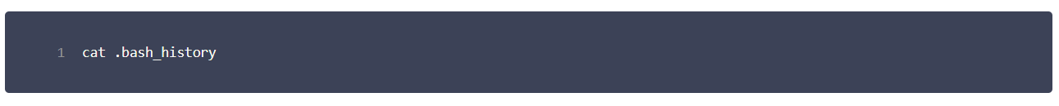
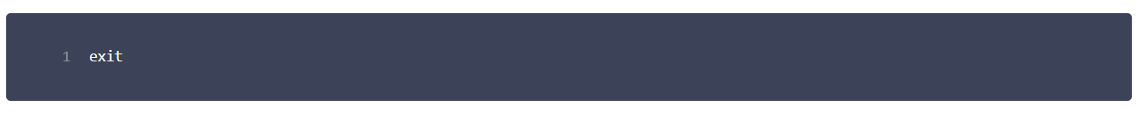
History:
history display the history of the commands you have typed in so far.
By default, It shows the last 500 recent commands.
Bash History:
Bash maintains the history to . bash_history file.
Exit:
exit to close/end a shell session.

Slide 13
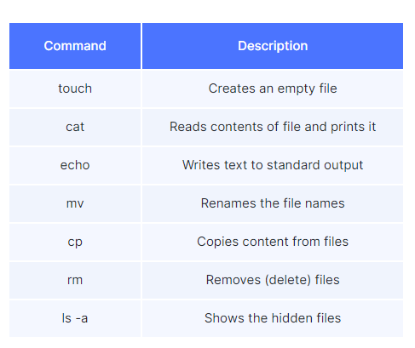
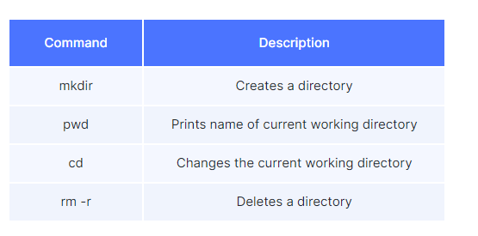
File Systems Commands

Slide 14
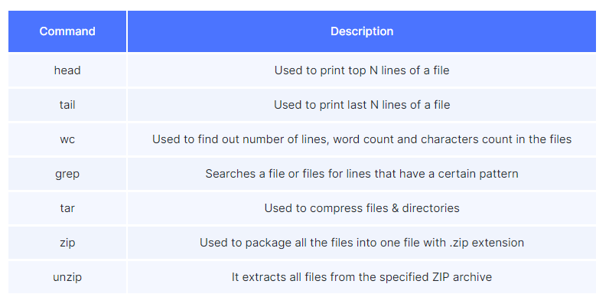
Files Commands

Slide 15
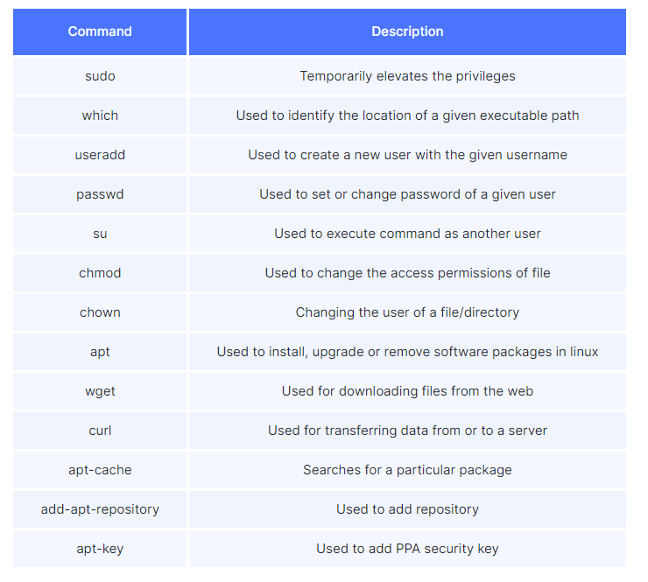
Miscellaneous Commands

Slide 16
Key Takeaways
Command Line Interface
Shell
Commands

